Slide 1
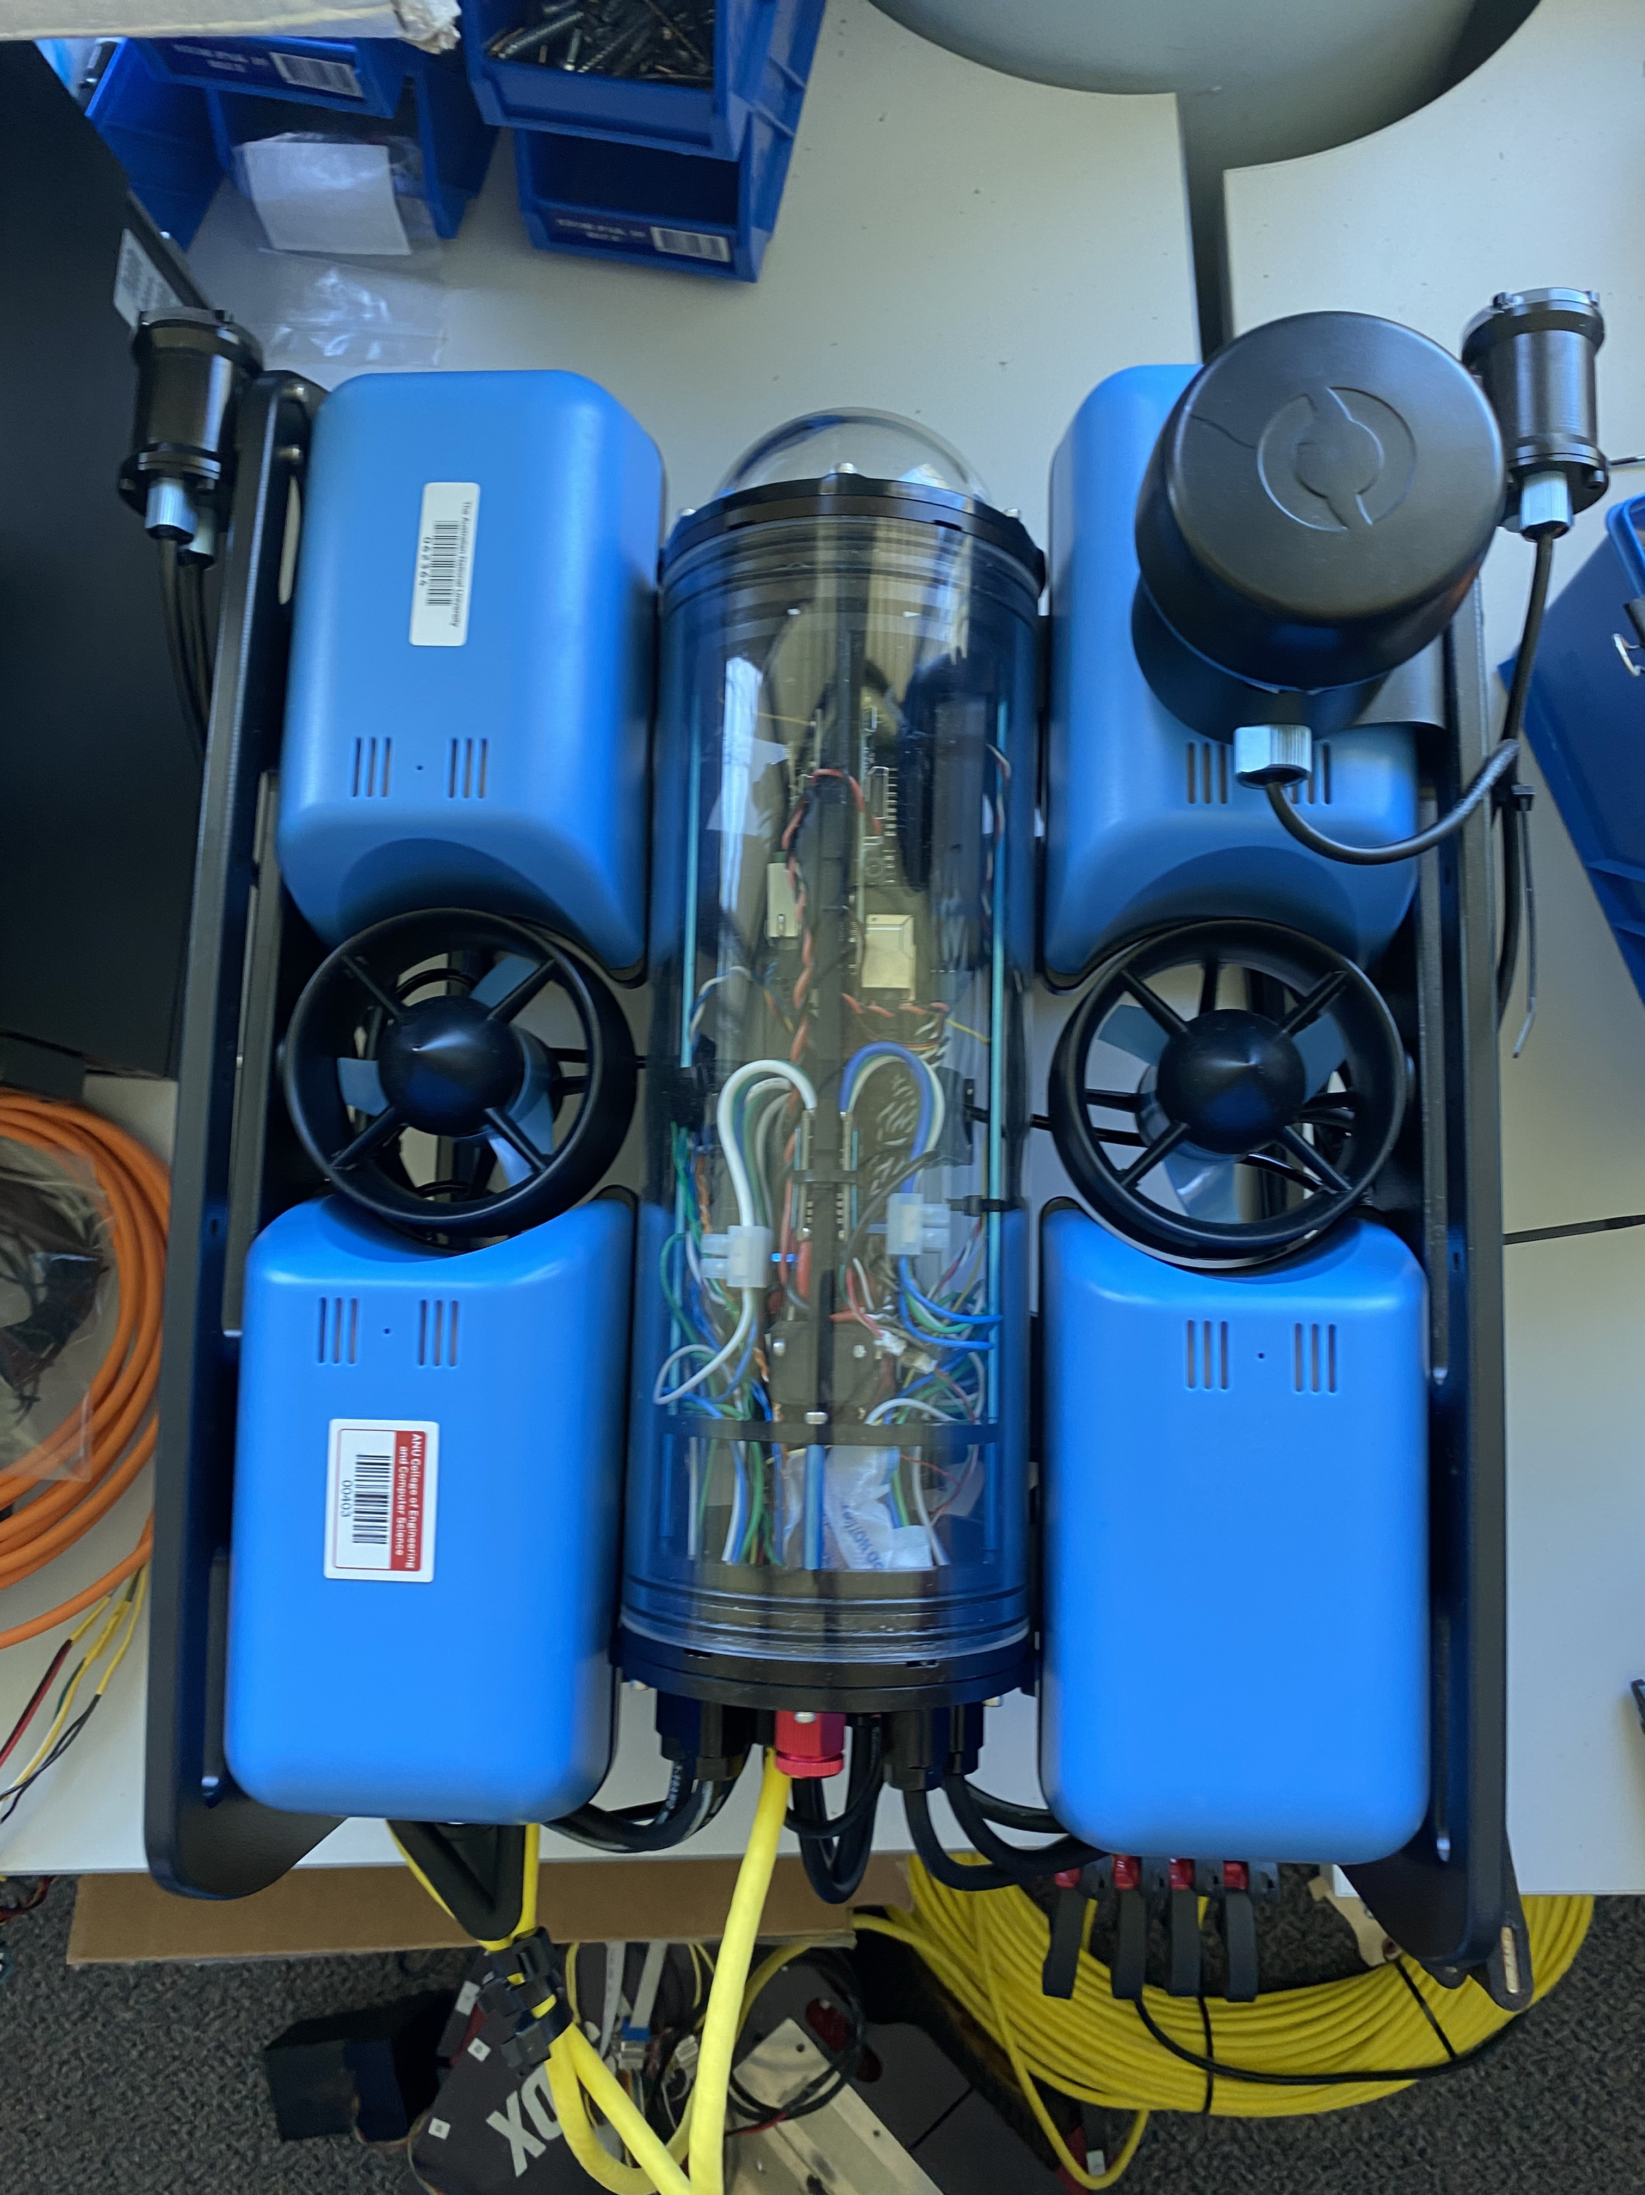
Multi-Beacon Ranging system for Underwater robotics
U5894374 Brian Ma
U7869326 Xingyu Luan
U7756428 Xiang Peng
U7559483 Yuqiao Xin
U7776558 Xu Ben
U7810272 Yuk Lam
U7757356 Yifan Wu

Slide 2
Team Formation
Brian Ma | Version Control, Embedded Programming
Xingyu Luan | Meeting Minutes, Embedded Programming
Yifan Wu | Liaising with clients, Embedded Programming
Yuqiao Xin | Preparing Audit Presentation, Embedded Programming
Xu Ben | Progression Tracking, Embedded Programming
Yuk Lam | Risk Management, Embedded Programming
Xiang Peng | Landing Page Design & Development

Slide 3
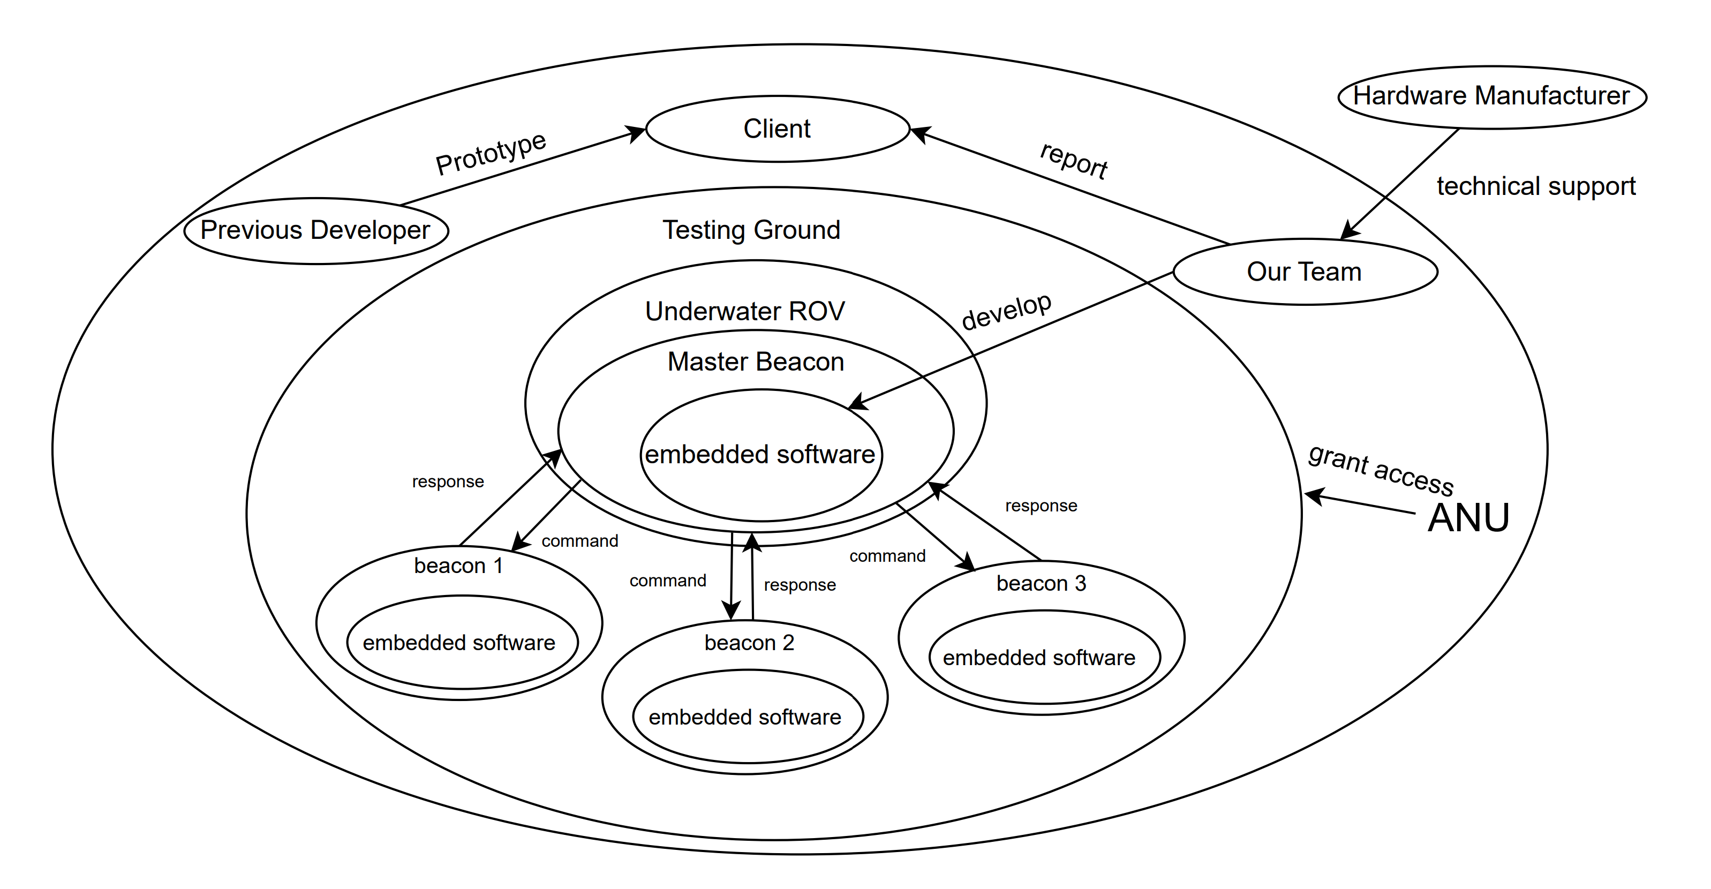
Project​ Scope

Slide 4
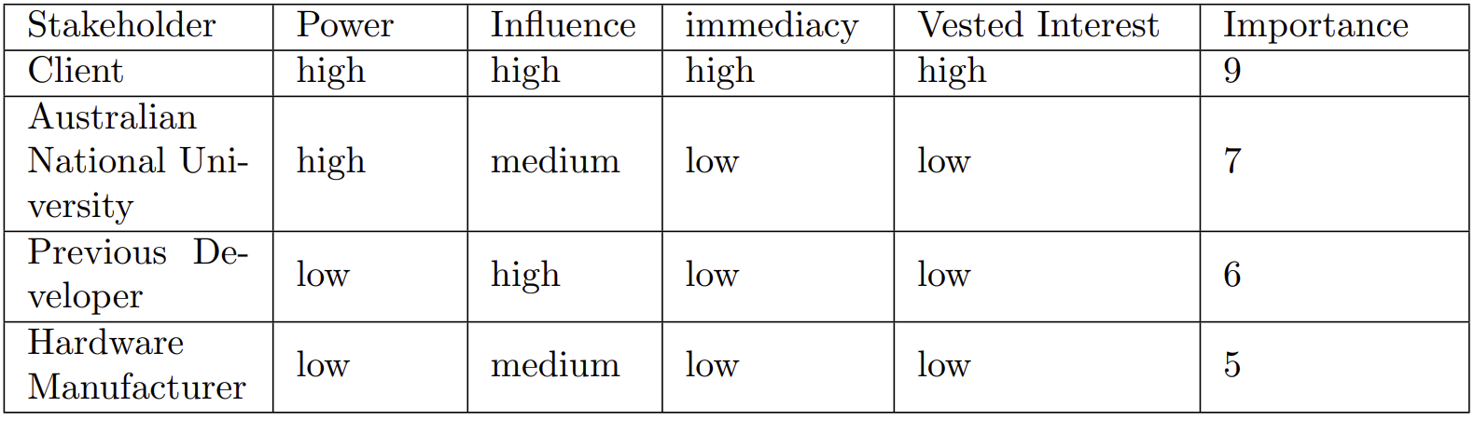
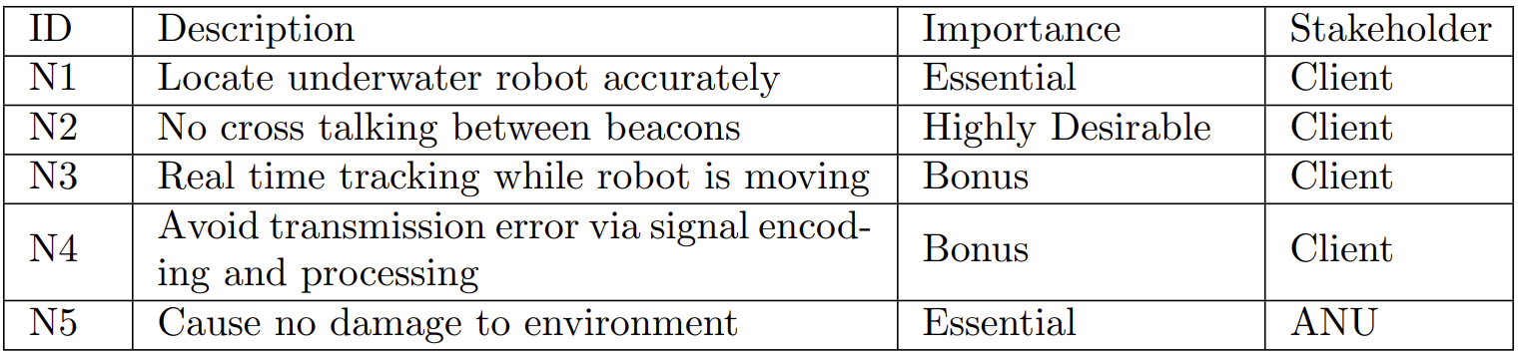
Needs List
Stakeholders

Slide 5
Assumptions
01 | Transmission within 20cm to 100m
02 | No additional hardware needed
03 | Transmission bandwidth within 1 to 10 Hz
Constrains
01 | Stable water properties(temperature, salinity, depth)
02 | Minimal background noise
03 | Stable beacons and boat movement
04 | Expandable system
05 | Reliable hardware and high-accuracy

Slide 6
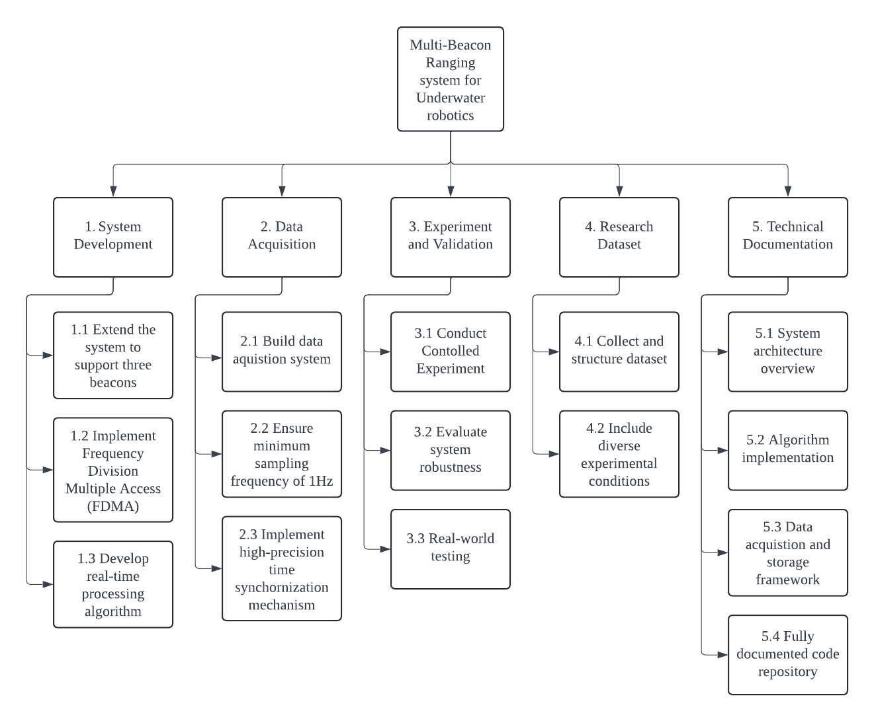
Deliverables

Slide 7
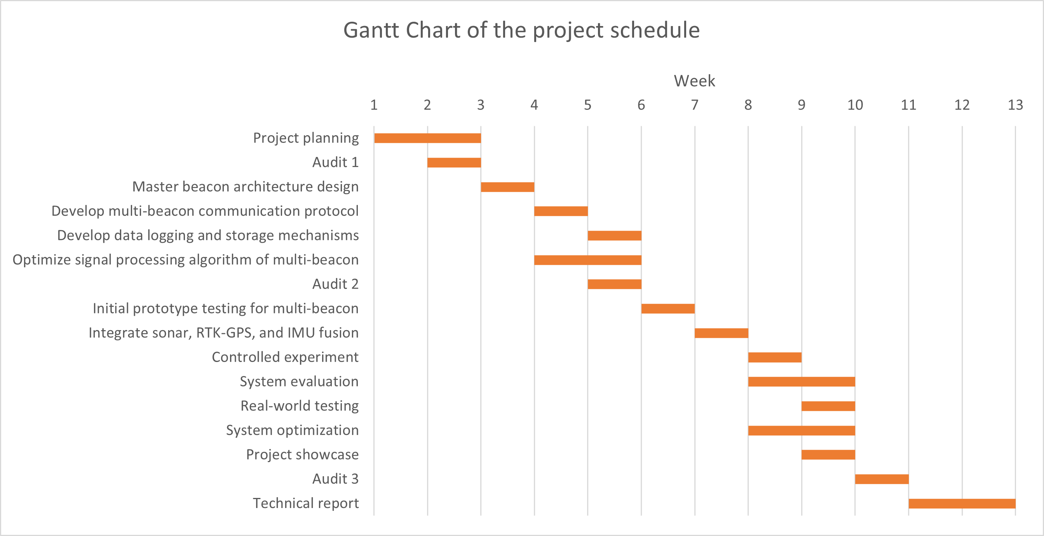
TimeLine and Milestones

Slide 8
Project Risks and Mitigations
Risk | Likelihood | Impact | Mitigation
Technical
Multipath Propagation | 4 | 3 | Echo suppression algorithms
Signal Interference | 4 | 4 | Time-division multiplexing (TDM)
Reliability
High Power Consumption | 5 | 3 | Optimize transmission intervals
Data Integrity Issues | 3 | 4 | Validate received data
Security
Signal Spoofing | 2 | 5 | Implement authentication mechanisms
Safety
Impact on marine life | 3 | 4 | Comply with marine safety regulations
Other
Testing Constraints | 4 | 3 | Secure alternative test sites

Slide 9
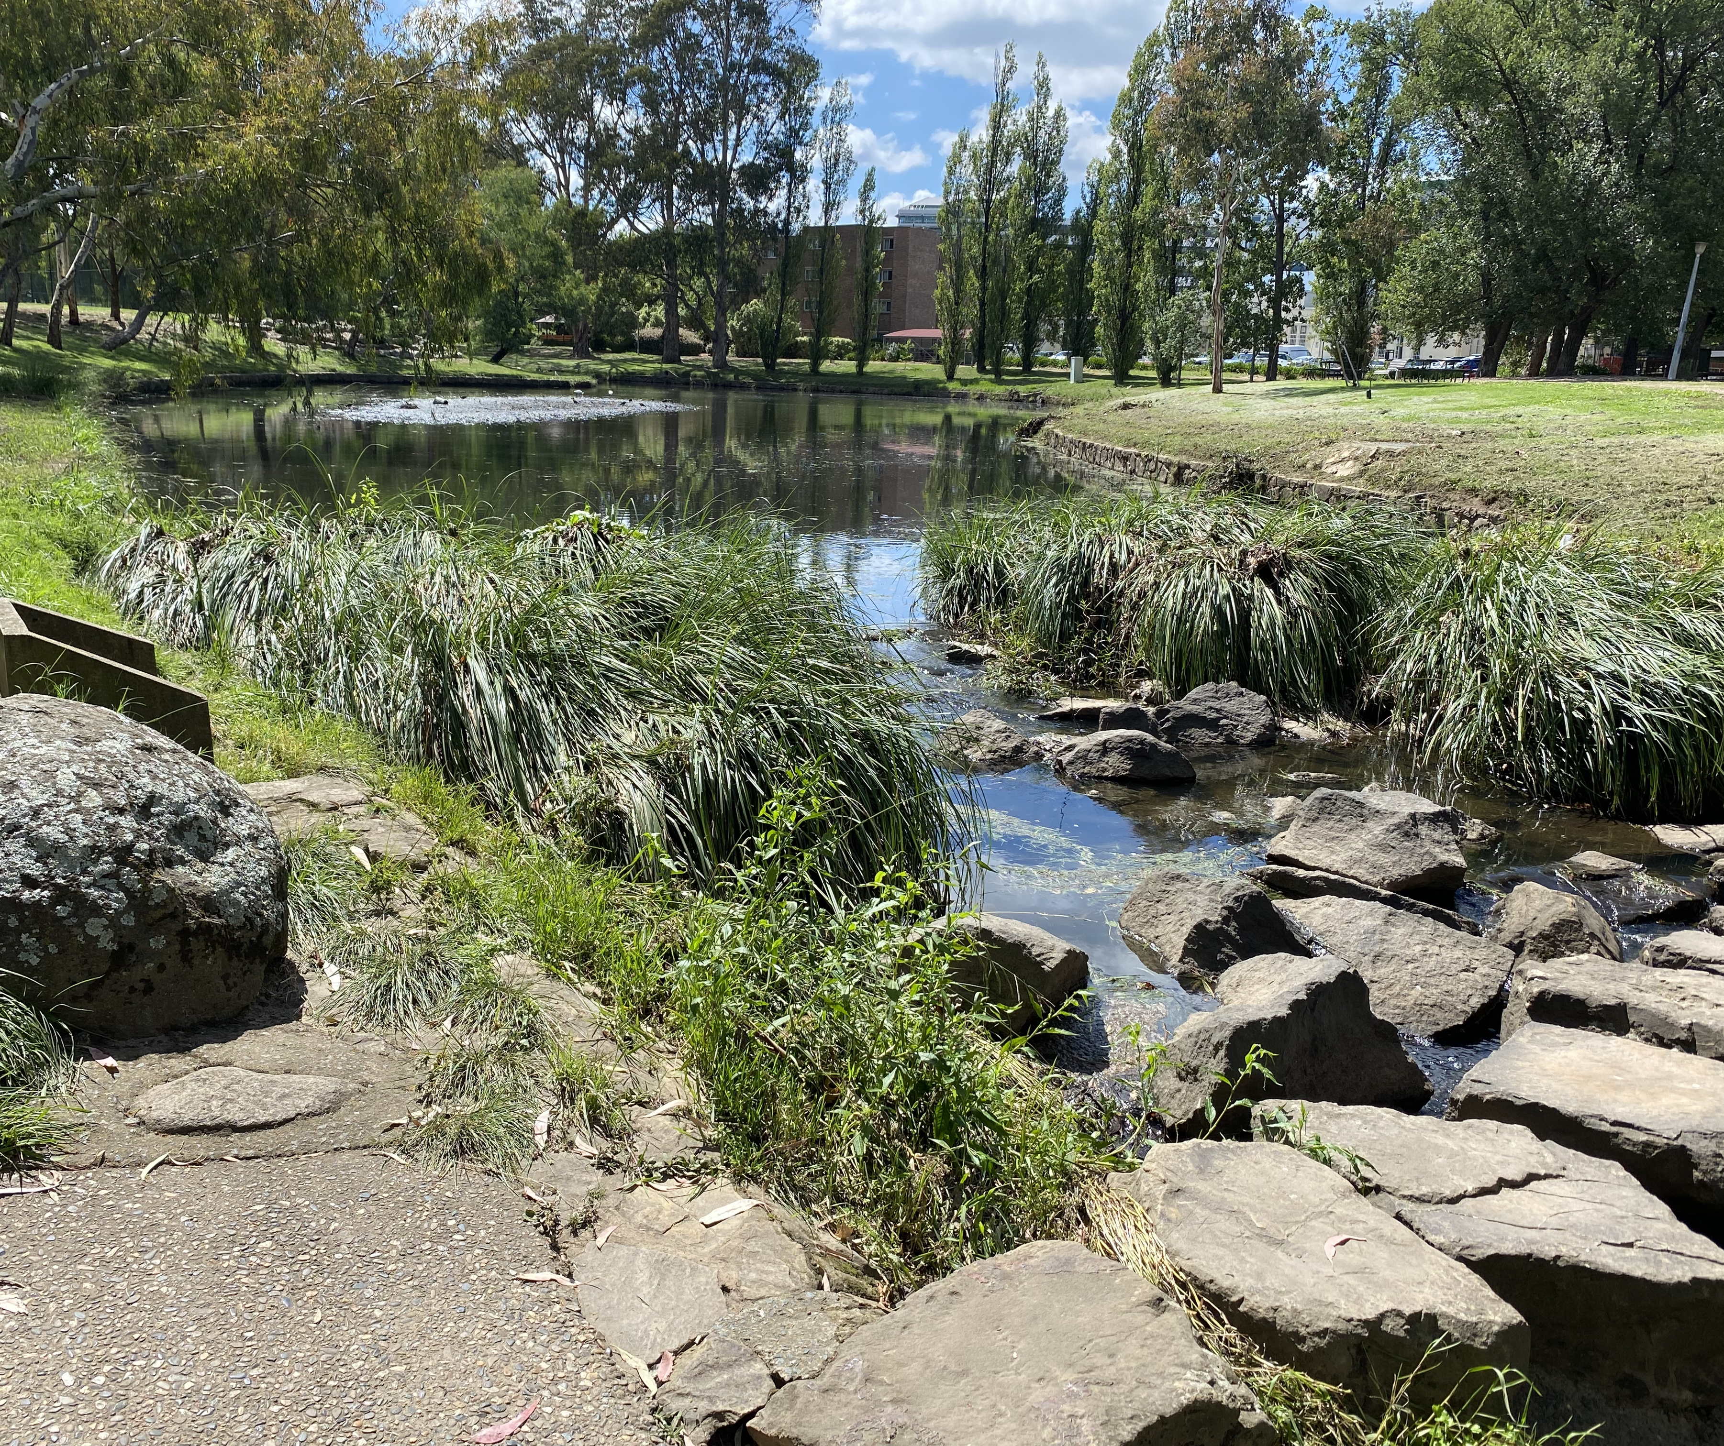
Thank you

